Slide 1
Bouquets and Blooms
We grow flowers for couples that love flowers. If you're looking for wildly romantic florals with a garden-gathered feel, you've come to the right place. Our wild signature style is inspired very much by the flowers that we grow in our field. Working with their intricacies and movement we create magic that is as unique to your day as your love story is. Working with your vision and colours we'll know exactly what to pick for your wedding day and we’ll have them arranged perfectly ready for you to collect when you need them.
We've put together some of our most popular choices, but if what you're after is a twist on what we do as standard, get in touch, it's your day, your way. ​

Slide 2
Simple Elegance
Our Bouquets and Blooms service is designed to be simple, offering you our most popular items to pick and choose to suit you.
This wedding package is most suitable for couples who want to do the flowers themselves; have a small or elopement wedding or just only want a few specific florals.
Once you've told us your colours and style, we'll do the rest and you can tick romantic florals off your list!

Slide 3
Bouquets
Small Bridal Bouquet £105
A perfect seasonal bouquet, matched to your moodboard and colour palette and finished with a natural jute ribbon
[+£12 for silk ribbon]
Standard Bridal Bouquet - £125
A larger seasonal mix, matched to your colours and finshed with a natural jute ribbon [+£12 for silk ribbon]
Bridesmaids Bouquet £62
A smaller version of your bouquet with all the same blooms and finished with a natural jute ribbon
[+£12 for silk ribbon]
Flower Girl Posy £20
A teeny posy, a miniature of yours, solidly tied and finished with a natural jute ribbon.
[+£12 for silk ribbon]
Flower Girl Wand £20
A willow star decorated with flowers, perfect matched with a flower crown and an enthusiastic flower girl!
[Add our luxury silk ribbons for £12]

Slide 4
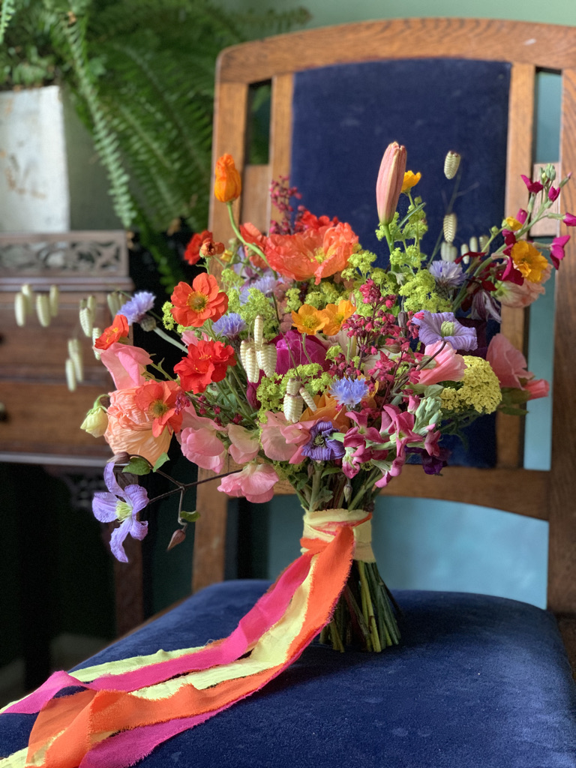
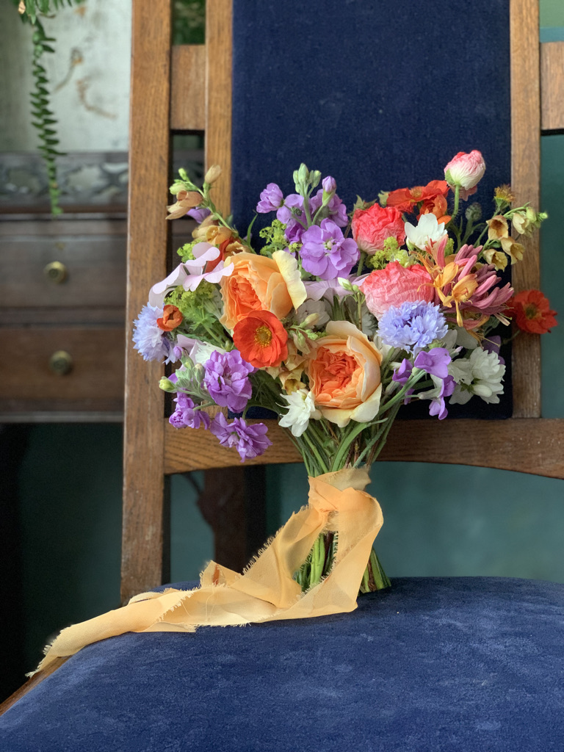
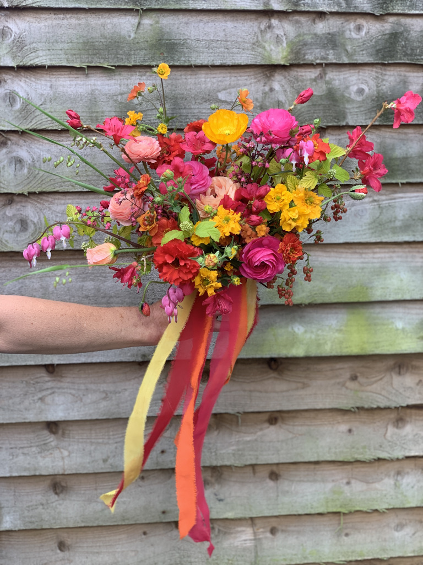
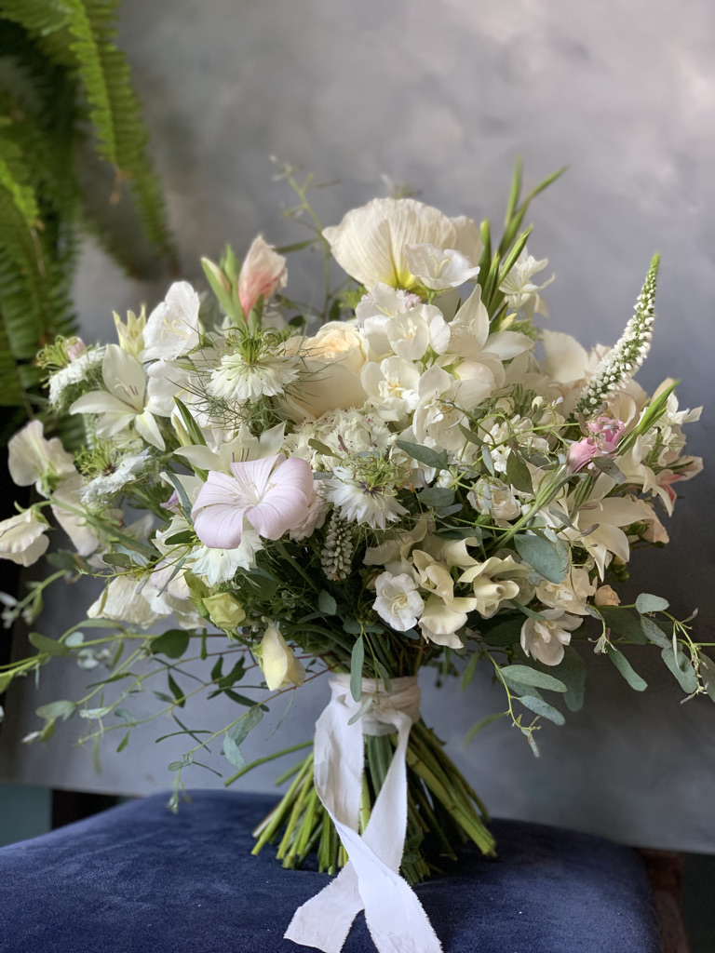
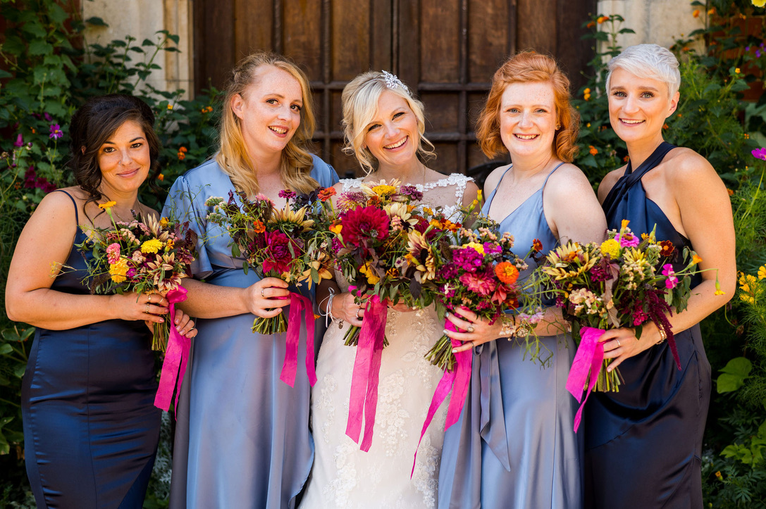
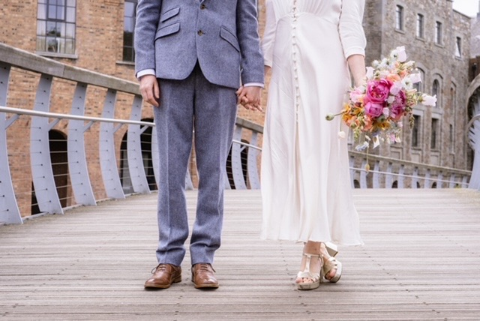

Slide 5
Buttonholes and Corsages
Buttonholes - £15
For the groom and his team, each finished with a pearl headed pin.
Corsage - £20
The perfect choice for ladies in your bridal party who want a little something extra they can pin on. More floriferous than a buttonhole and tied onto a corsage pin so easy to attach.
Wrist Corsages - £30
Tied on a silk ribbon, the seasons perfect blooms in a perfect arrangement for you to admire.

Slide 6
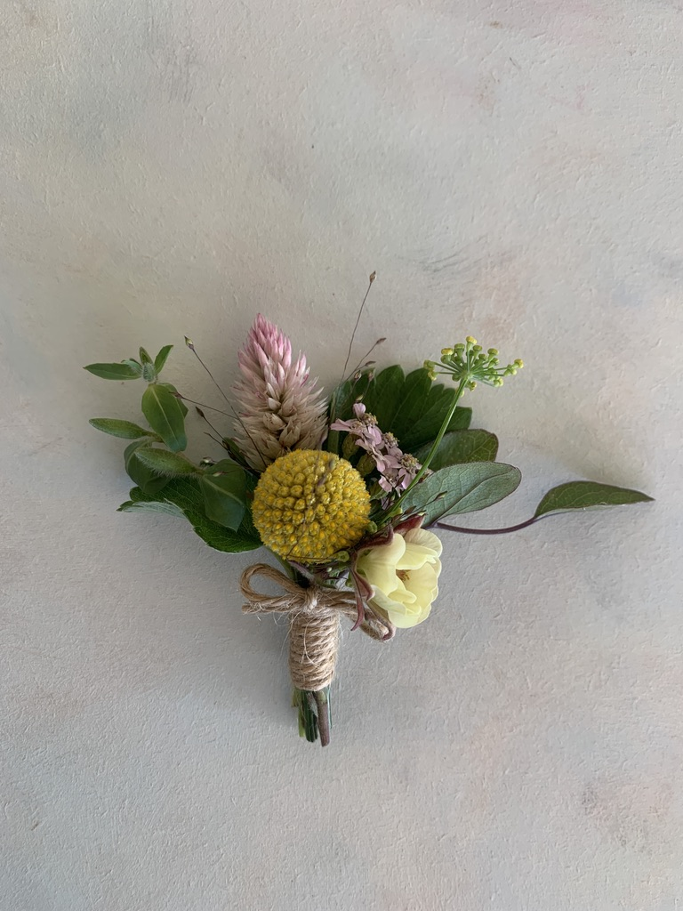
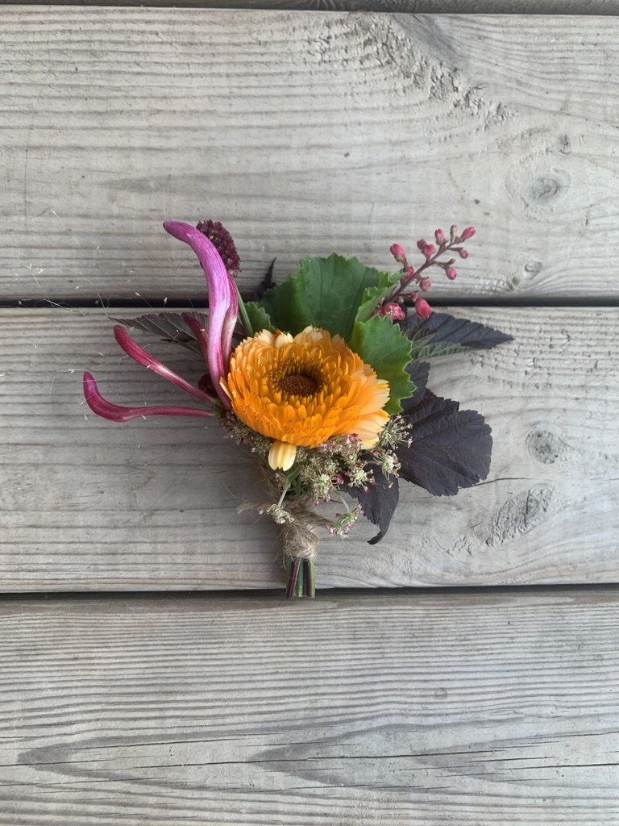
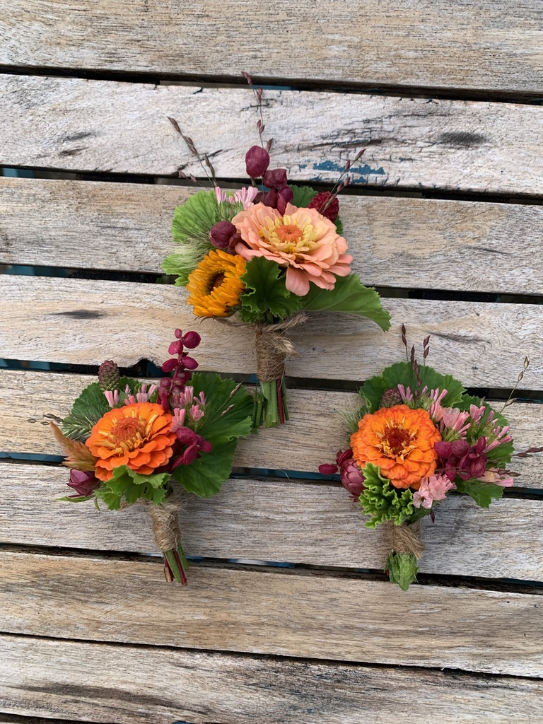
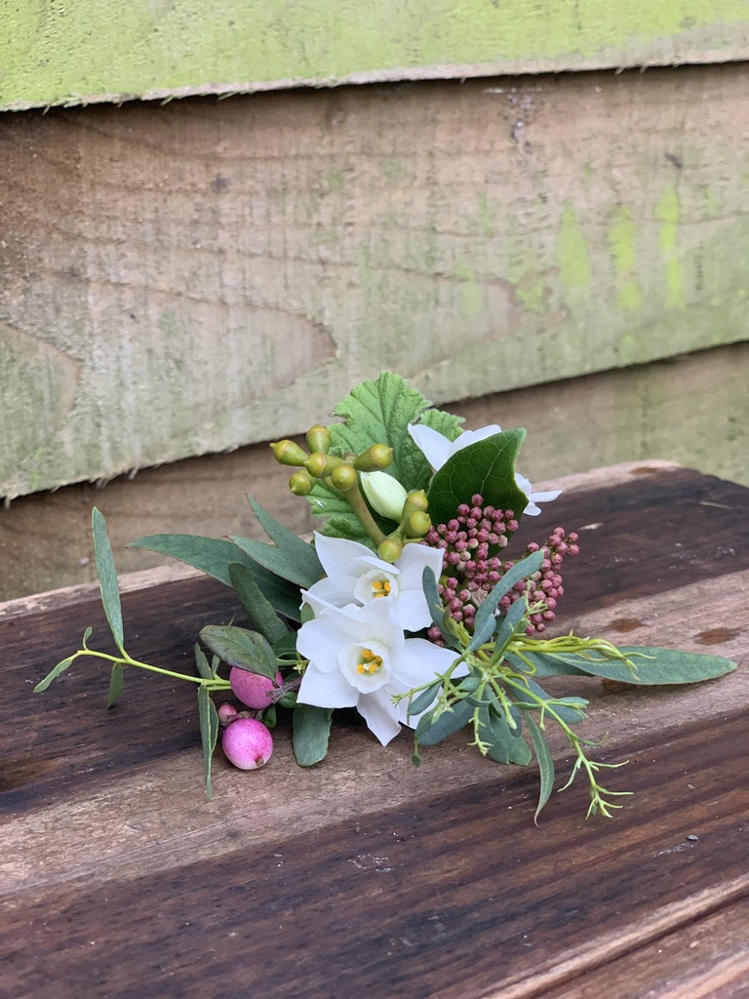
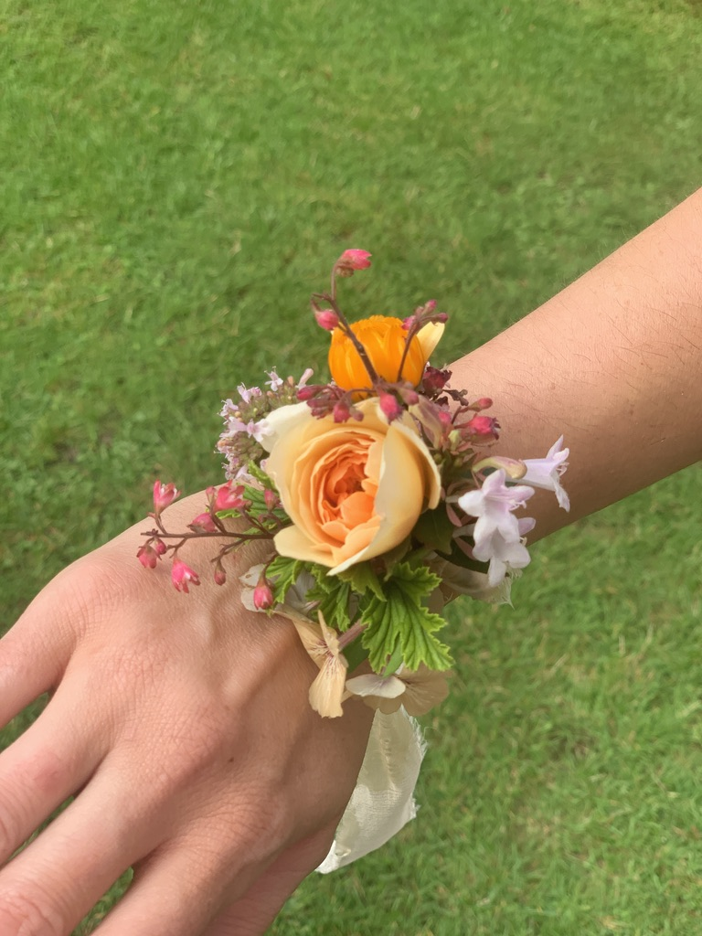

Slide 7
Flower Crowns
Full adult flower crown - £65
Perfect for a festival wedding or just someone who loves to celebrate how much they love nature. Every design original and perfectly matched to your bouquet.
[Add our luxury natural silk ribbon for +£12]
Adult half-crown - £45
A half crown of blooms, perfect if you have a veil or a beautiful up-do.
[Add our signature ribbons for +£12]
Child flower crown - £35
A full crown of seasonal blooms and foliage, woven onto a wire band and supplied with hair pins.
[Add our signature silk ribbon for +£12]

Slide 8
Bloom Buckets
Large Bloom Bucket (60-80 stems)- £80
Our large bucket has enough blooms for several large vases or a minimum of 6 jam-jars.
If you’re doing your own bouquets, we’d suggest allowing 3/4/bucket for a bride to give you plenty of choice and ½ a bucket for a bridesmaid
Large foliage bucket - £70
The seasons best foliage, scented, trailing and wispy. Perfect for naturalistic arrangements.
Please let us know what you are planning on creating so we can choose the right kind of foliage which will work the best.
Trial half bucket (30-40 stems) - £40
We always recommend that you have a trial half bucket of blooms a week or two before your big day so you have plenty of time to practice what you’re creating. Your bucket will contain as close a selection to in your wedding flowers as the field has in flower.

Slide 9
Table Arrangements
Trio of Bud vases - £27
Creating a chic tablescape is easy with our bud vase collection. All vases are yours to keep after the big day, so no need to wash and return them, just give them away.,
Our vases work well as trios along your table, but by ordering multiples of three, you can set them out however you like.
Bowl arrangements - £65
Our modern bowls are the perfect centre piece for round tables seating up to 10. Arranged low so your guests can chat over the top of them, they’ll be brimming with scent, movement and effortless style.

Slide 10
Our booking process
The process is simple.
Have a look through what we offer. Fill out our enquiry form with your colour scheme, requirements and date.
We will then confirm our availability and if you'd like to book us we kindly ask for a booking fee of £100 or 10%, whichever is greater. This is non-refundable but is deducted from the final invoice, payable a month before the wedding.
There’s the option to book a visit to us on our farm, we typically do this a month before your wedding day.
Otherwise, we will then be in touch a month before your wedding day to finalise details.
We will have your flowers ready for collection on either the Thursday or Friday, depending on what you’d like. Please note, flower crowns and wands are better collected the day before your wedding.

Slide 11
Come and see us
Some of our couples love to come and see us, to get a feel for where their wedding flowers have been grown. We are only just outside Bristol in Tockington and are open by appointment only.
If you know that’s you and you want to have a guided tour with one of us, we’d love to have you! We’ll arrange a time with you and give you a tour of our field. We always ask that you see us a week or two before your wedding so the flowers are as close to what you’ll have as possible. Then we’ll leave you to browse at leisure, to fill a bucket with blooms at your own private pick your own session – bring any of your bridal party that’ll help you fill the bucket and then you’ve got plenty of time to practice at home with your vases.
You might arrive not being sure what your favourites are, but you’ll leave having fallen in love with flowers. Of course your final wedding blooms will be as close to this as we can pick on the day, so be ready for the photograph to remind us of your favourites, we’ll definitely be taking one!
Monday – Friday (9-5pm)
£50

Slide 12
Charlotte and Jack
Thank you from the bottom of my heart for the most gorgeous flower creations for our wedding last weekend. They blew me away. I had such a high level of confidence in you guys and you exceeded my expectations They were more than perfect.
The buttonholes were charming, the vases fabulous - the restaurant looked amazing. One of my favourite moments was walking in to see the space and not quite knowing what it was going to be like, but being so excited because I knew the bouquet was so wonderful.

Slide 13
Imogen & Sam
A massive thank you for our gorgeous flowers. They were so perfect for our big day. Honestly, loved them so much, the colours and textures were just perfect.

Slide 14
Joss and Daniel
Fabulous flowers! Just what we wanted! And not a sneeze or a watering eye to be seen.
Photograph: @johnnybarrattphotography

